Slide 1

INSTITUTE UIE
DEPARTMENT ACADEMIC UNIT-1
Bachelor of Engineering (Computer Science & Engineering)
Subject Name Introduction Electrical & Electronics Engineering
Subject Code-23ECH-101
Prepared By
Dr. Shikha
Unit-1 Chapter-3
Basics of Electrical & Electronics Circuit
Lecture No. 1.3.6
K-MAP
DISCOVER . LEARN . EMPOWER

Slide 2
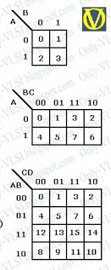
Lecture Objectives
S. No. | Objectives
1 | To make student aware about K-map formation.
2 | To impart knowledge about simplification of SOP and POS expressions using K-Map.
3 | To make and understand the concept of do not care terms and their role in logic simplification.

Slide 3
Course Objectives
S. No. | Objectives
1 | Understand Electrical & Electronics Engineering Fundamentals
2 | To prepare students to perform the analysis and design of various Electrical & digital electronic circuits.

Slide 4
Course Outcomes
CO Number | Title | Level
CO1 | To identify the different types of electrical elements and the basic op-amp circuit elements and to illustrate the various types of motors, transducers. | Remember
CO2 | To understand basic principles of transformers, transducers, op-amps, DC and AC motors and to compare the different methods for analysing electrical and magnetic circuits. | Understand
CO3 | To derive the relationships between parameters in electric and magnetic circuits and motors and to determine specifications of op-amps. | Analyze
CO4 | To solve the basic problems related to electric circuits, magnetic circuits and motors and to assess the characteristics of different configurations of op-amps. | Evaluate
CO5 | To design the different applications of transducers, motors as well as the op-amps like adders, subtractor and comparators. | Create

Slide 5
Karnaugh Map
Boolean expression representation
Y= AB’C+ABCD’+AC’D’
Y = (A+B’) (A’+B+D’)(A+D’)
K map
Simplification using K map
SOP Form & POS form
Don’t care

Slide 6
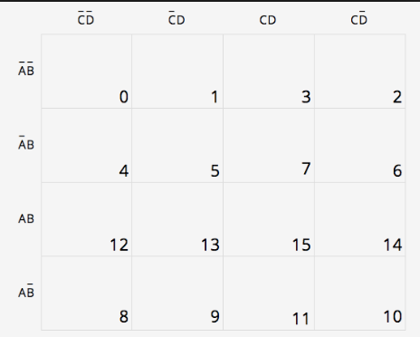
Karnaugh maps (K-maps) are graphical method for the simplification of Boolean functions. K- maps consists of cells Cells = 2^{n} where n = no of i/p variables. K-map cells are arranged so that adjacent cells differ in only one bit position (based on gray code).
K- maps
Figure 1.2 cells of k-map [2]

Slide 7
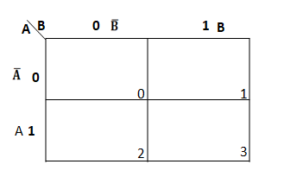
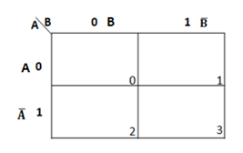
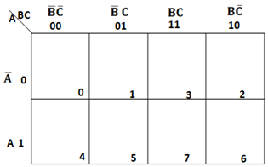
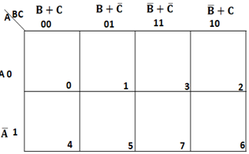
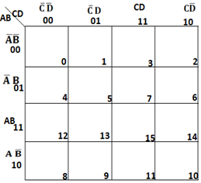
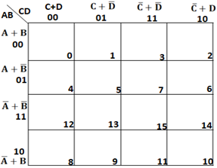
Input Variables | K map for SOP form | K map for POS
2 (AB)
3(ABC)
4 (ABCD)

Slide 8
Steps to solve expression using K-map
Draw the Karnaugh map depending on variables as given in question.
Identify minterms (SOP ) and Maxterms (POS) as given in problem.
For SOP put 1’s in blocks of K map according to minterms.
For POS put 0’s in blocks of K map according to maxterms.
Make groups/pairs containing total terms in power of 2 like (2,4,8,16) Try to make the largest possible pair.
Find product terms with variables (that are unchanged along rows and columns ) for each group and sum up for SOP form.
Find sum terms with variables (that are unchanged along rows and columns ) for each group and ANDED them for POS form.

Slide 9
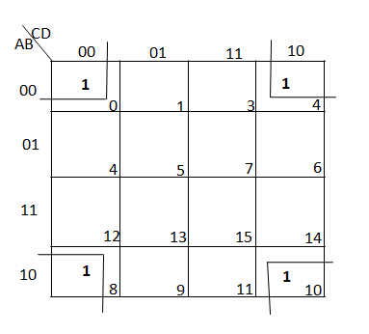
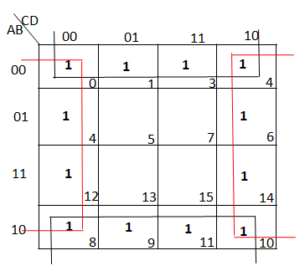
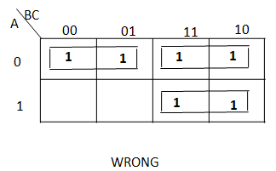
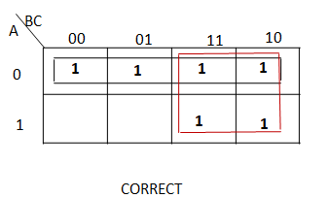
Pairing Rules of K-map
Adjust cells can be paired.
Corner elements can be paired . 3. outermost rows as well as outermost columns can be paired respectively.
4. Try to make largest possible pair as shown.

Slide 10

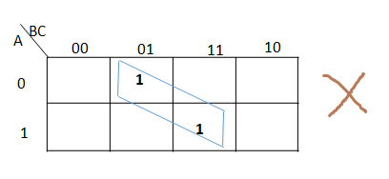
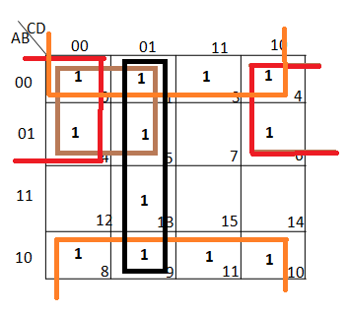
5. Groups may overlap. 6. Diagonal pair is not possible.
7. Make sure in each pair ,there must be one unpaired 1(sop) or 0(pos) .
Pair in brown colour is not possible as it does not contain any unpaired 1.

Slide 11
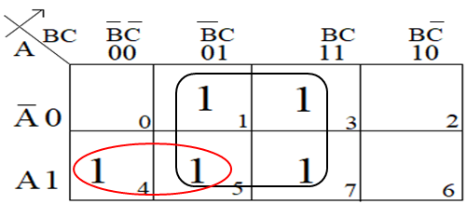
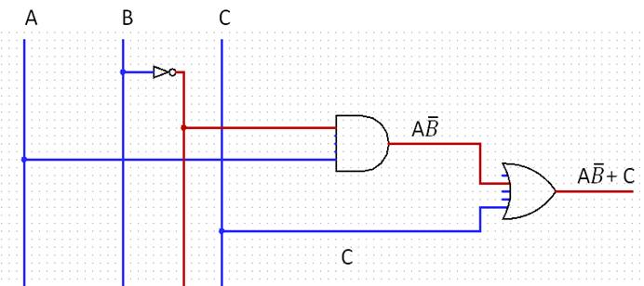
Questions on K- Maps (SOP)
Example: Simply F(A,B,C) = ∑ m( 1,3,4,5,7) using K – map and realize the circuit using AOI gates.
(a) K-map
(b) Realization using gates.
Output Expression : F= AB’ + C
Notes:
This slide is animation based so view it in slide show mode for better understanding and colour of pairing in the k-map resembles the colour of corresponding term in the expression to avoid confusion.

Slide 12
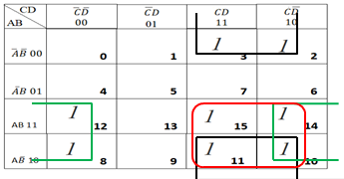
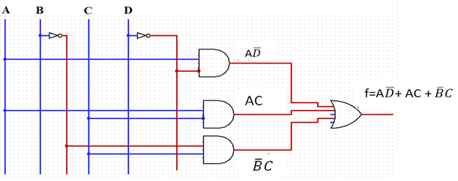
Questions on K- Maps( SOP )
Example: Simply F(A,B,C,D) = ∑ m( 2,3,8,10,11,12,14,15) using K – map and realize the circuit using AOI gates.
(a) K-map
(b) Realization using gates.
Output Expression : F= AC + AD’ + B’C
Notes:
This slide is animation based so view it in slide show mode for better understanding and colour of pairing in the k-map resembles the colour of corresponding term in the expression to avoid confusion.

Slide 13
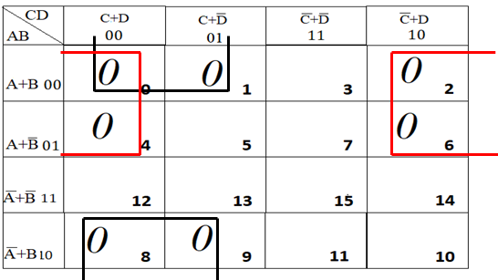
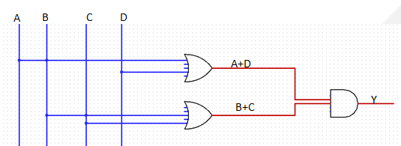
Questions on K- Maps (POS)
Example: Simply F(A,B,C,D) = ∏M( 0,1,2,4,6,8,9) using K – map and realize the circuit.
(a) K-map
(b) Realization using gates.
Output Expression : F= (A+D) (B+C)
Notes:
This slide is animation based so view it in slide show mode for better understanding and colour of pairing in the k-map resembles the colour of corresponding term in the expression to avoid confusion.

Slide 14
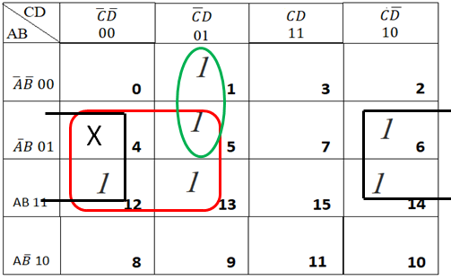
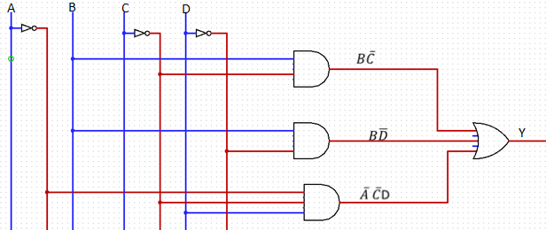
K-map with Don’t care conditions:
Example: Simply F(A,B,C,D) = ∑m( 1,5,6,12,13,14)+d(4) using K – map.
(a) K-map
(b) Realization using gates.
Output Expression : F=BD’+ A’C’D + BC’

Slide 15
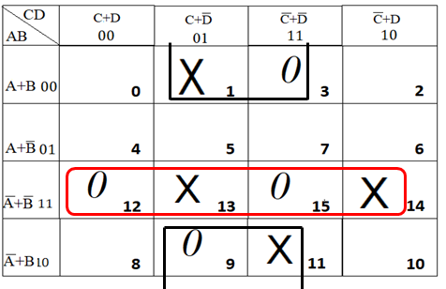
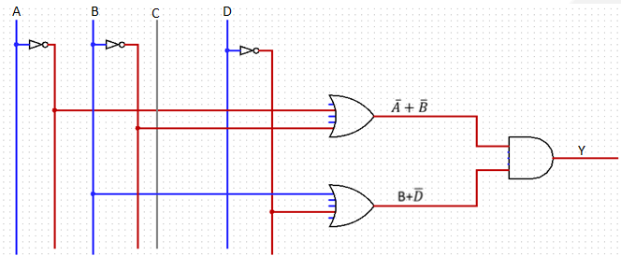
K-map with Don’t care conditions:
Example: Simply F(A,B,C,D) = ∏M(3,9,12,15)+Փ(1,11,13,14) using K – map and realize the circuit.
(a) K-map
(b) Realization using gates.
Output Expression : F=(B+D’) (A’+B’)
Notes:
This slide is animation based so view it in slide show mode for better understanding and colour of pairing in the k-map resembles the colour of corresponding term in the expression to avoid confusion.

Slide 16
APPLICATIONS
Computers
Calculators
ATM
Mobile Phone
Integrated Circuits and so on......

Slide 17
REFERENCES
http://only-vlsi.blogspot.com/2009/01/boolean-expression-simplification.html
https://www.google.com/search?tbm=isch&q=karnaugh+map+grouping&chips=q:karnaugh+map+grouping,g_1:k+map&usg=AI4_kQxn1GFLOgRA5XEOFWdHPcK4HmC8w&sa=X&ved=0ahUKEwie98rzl_3iAhWILo8KHcmABz0Q4lYIKygC&biw=1366&bih=657&dpr=1#imgrc=7j--zw4XwWyeiM:
Floyd & Jain, Digital Fundamentals, Pearson.
https://www.google.com/search?biw=1366&bih=657&tbm=isch&sa=1&ei=Ki4OXdSzG5L0rAH3jpjYCw&q=karnaugh+map+examples+with+solutions&oq=karnaugh+map+examples&gs_l=img.1.3.0j0i24l6.228061.233126..236212...0.0..1.463.4033.0j5j8j2j1......0....1..gws-wiz-img.......0i67j0i8i30.zfc8Yep3OZY#imgrc=nAjGgOZxU_LuCM:
Mano,Morris, Digital Design, Prentice Hall of India.
Fletcher, An Engg. Approach to digital design, Prentice Hall of India.
http://www.geeksforgeeks.org/digital-electronics-logic-design-tutorials/
http://www.ni.com/example/14493/en/
http://195.134.76.37/applets/AppletGates/Appl_Gates2.html

Slide 18
THANK YOU

